Slide 1

Property tax reform in developing countries: key isues and challenges
Rajul Awasthi
(rawasthi@worldbank.org)
Global Tax Team

Slide 2
Contents
Introduction: why property tax?
The numbers tell us there is potential
Key policy issues in property tax reform
Key issues in property tax administration
World Bank projects on property tax – a survey of 20 years’ experience
The problems in a low-capacity jurisdiction: the case of Sindh province in Pakistan
Typical budget and timeline for a property tax project

Slide 3
Why Property Tax?
OECD (2010) “tax and growth ranking” - recurrent taxes on immovable property (and residential property in particular) the least distortive tax instrument with respect to its effect on long-term growth.
Property taxes generally considered to be more efficient than other types of taxes: their impact on the allocation of resources in the economy is less adverse—by not affecting decisions to supply labor and to invest (including in human capital) and innovate.
Property taxes considered an ideal source for local governments by virtue of being borne mainly by residents and because they fall on immobile assets within each jurisdiction.
They help strengthen local accountability.
Property taxes can be part of a policy to produce a more progressive tax system.

Slide 4
Property taxes are under-utilized, especially in the developing world: Property Tax Revenues as a share of GDP
 | 1970s | 1980s | 1990s | 2000s
OECD countries | 1.24 | 1.31 | 1.44 | 2.12
Developing countries | 0.42 | 0.36 | 0.42 | 0.60
Transitional countries | 0.34 | 0.59 | 0.54 | 0.68
All countries | 0.77 | 0.73 | 0.75 | 1.04

Slide 5
In OECD countries, the revenue uptake from property taxes is higher

Slide 6
Key policy and design issues
Political considerations often result in a plethora of exemptions, eroding the tax base
Introduction of property tax systems could create the problem of “asset rich, income poor” property owners who lack the capacity to pay the taxes demanded; “transition schemes” are often resorted to for ensuring smooth implementation without strong political opposition
Many jurisdictions rely on Property Transfer Taxes (aka Stamp Duties) for revenues, rather than on annual, recurrent property taxes; in general transfer taxes are far more distortionary
Valuation methods vary and need to be carefully chosen in line with the enabling environment; mass valuation models (CAMA) aided by ICT systems are “best practice solutions” but may lead to difficulties in implementing (data needs are intense, capacity of regular updates absent)
Other valuation methods more appropriate to the ground realities – ARV, Area Based, etc – may be suitable

Slide 7
Key issues in property tax administration
In most developing country jurisdictions, a key constraint is the absence of a sound, reliable register of properties; tax base must be fully covered and preferably mapped using a GIS-based mapping system so that it captures all essential features of the properties - in urban centers three dimensional mapping is critical.
GIS-based mapping is an expensive investment and beyond the reach of most municipalities/local governments. The World Bank has a clear role in making this investment here.
Property taxes can be very simple to comply with given most properties don’t change year-to-year (unlike business profits, for example) but need a sound, efficient ICT-based taxpayer interface
Scope for technological innovations and modern applications including mobile apps
The main challenges – as in all tax administration - remain enforcement and risk management
Many developing countries have a real need to improve the capacity of property tax officials and provide them training in latest techniques of tax assessment and enforcement.

Slide 8
World Bank projects experience with property tax reform –
a survey of 20 years

Slide 9
Overview: Regions and Commitments
Regional Distribution
Notes:
Project Count: Africa:16 , ECA:18 , Lac:9 , EAP: 8 , MENA:3 , SA:3 -- Out of 56 Projects
Notice: 1/3 of total projects and commitment
AFRICA 1,168,250,000.00 /// MENA 83,212,342.00 /// SA 200,000,000.00 /// ECA 421,349,288.00 /// EAP 456,767,975.00 /// LAC 1,279,660,356.00
Resonating/Reflects the feeling and probably the reality of ECA being the biigest spor

Slide 10
Overview: Bank Instruments
Project types/instruments

Slide 11
Characteristics of successful projects
Country Context and Political Support
Valuation
Enforcement
Formalizing Land
ICT Options
Valuation Method (Zones, Value, Self-Assessment)
National vs. Regional Responsibility
Reduce Tax - Broaden Base
Law on Valuation/ Valuers
Dialogue with Taxpayers
Dispute Resolution Mechanism
Consolidation of Laws
Backlog and Arrears
Clear Selection Criteria
Maintenance and Quality Control
COTS vs. custom-built
Including Vulnerable Groups
Dispute Mechanism
Earmarking/ Reciprocity – Services for Tax
Alignment w. Gov. Agenda: Decentr./P.S.D.
Administration with history of cooperation
Prior Actions
Compliance and Customer Orientation
Project Management
Behavioral Approaches/ Outreach
Service for Tax Payments
Project & Mitigation Strategy
Performance Indicators
Institutional Reform
Inter-governmental Cooperation
Dual Agency vs. Integration

Slide 12
Property tax reform in a low-capacity jurisdiction:
The case of Sindh, Pakistan

Slide 13
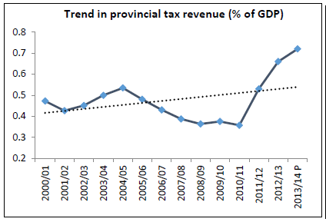
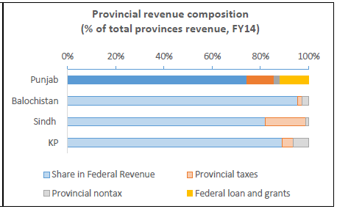
Pakistan: Own source revenue of provinces is very low, about 0.7 percent of GDP

Slide 14
In Sindh, the split between property taxes and stamp duties is roughly 50:50 Example: Sindh

Slide 15
Key challenges in property tax administration in Sindh
Institutional – administration fragmented with three agencies dealing with various aspects of property tax administration (BoR, E&T, SRB)
Tax base – lack of modern, updated property tax register with all properties mapped using GIS
Administration – need to modernize offices, use ICT systems and web-based property tax administration
Valuation - current valuation tables outdated, far below latest market values
Property tax law - large number of exemptions erode the tax base

Slide 16
Reform goals for the future in Sindh
Putting in place a modern, ICT based administration –
Complete property register with 3-D mapping, property attributes identified
Taxpayer friendly, internet-based e-filing and e-payment system
Self-assessment regime with a strong risk-based enforcement
Development of capital value-based property taxes –
Valuations of properties updated regularly and systematically to reflect market values
Need for setting up a professional valuation unit and systematic collection of relevant data
In the long run, create mass valuation models; this requires multivariate skills in valuation, statistics, economics, geo-spatial and GIS, and computing

Slide 17
Budget and
timeline
template
Activity | Timeline | Approximate Budget ($ million)
Legislative review and proposed reforms | 6 months | 0.5
Review of the valuation methodology and suggestions for reforms | 6 months | 0.5
Preparation for carrying out extensive survey of all urban areas, including contracting | 3-6 months | 0.1
GIS based survey of all urban areas | 18-24 months | 10 - 15
Review of methods of taxpayer user interface and development of plan for introduction of electronic and on-line taxpayer interface | 6 months | 0.5
Undertake BPR, review the features identified for a modern integrated property tax application; develop technical User Requirements Specifications for the new system | 9-12 months | 1 - 2
Review office infrastructure and develop plan for modernization of offices | 6 months | 0.5
Develop detailed project implementation plan | 3 months | 0.1
Procure ICT system | 18 months | 5 - 10
Procure office infrastructure and other items for modernization of offices | 18 months | 2
Capacity building of PT staff through training in the areas of valuation procedures and methodologies, Billing and collection systems, customer service centres and computerized GIS based administrative systems. These could include international study tours | 12-18 months | 1
Human resource planning and staff needs development | 6 months | 0.5
Rollout of legal reforms and valuation methodology, including communications strategy | 12 months | 1 - 2
Rollout of new taxpayer interface and ICT systems deployment | 12 months | 0.5
Total | 5-6 years | 23- 35 million

Slide 18
Main take-aways
Data on sub-national taxation indicates much room for increase in revenues
Worldwide, a major revenue handle for most sub-national governments is property taxation
Need to move away from property transfer tax (i.e., stamp duty) to recurrent property taxes
An agenda for property tax reform needs to follow international best practices:
an efficient registration system;
three dimensional rights;
discourage false price declarations, develop transaction registers, create valuation models which reflect market prices

Slide 19
Thank you!
rawasthi@worldbank.org

